Slide 1
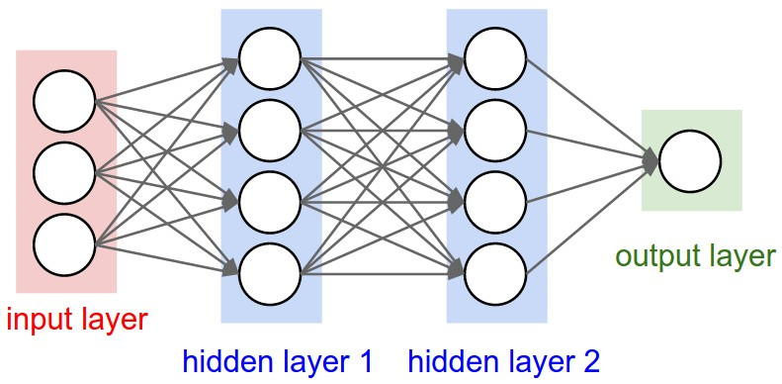
This time: Neural Networks for Visual Data

Slide 2
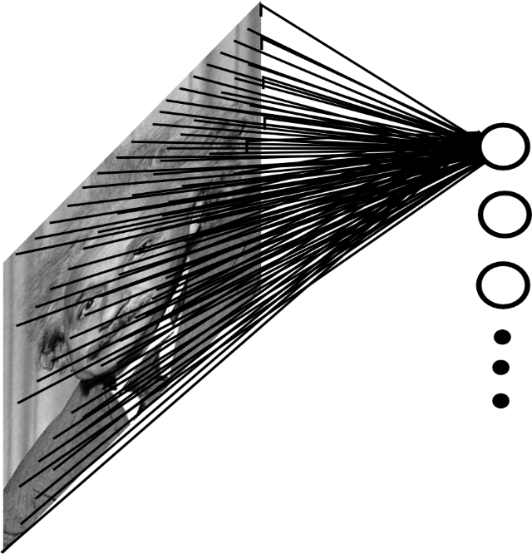
Fully Connected Layer for Visual Data
Example: An affine (FC) layer from
200x200 images to 40K hidden units
~2B parameters!!!
- Spatial correlation is local
Waste of resources + we have not enough
training samples anyway..
Ranzato

Slide 3
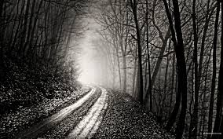
Convolutional of Two Signals
Note: to implement convolution with a sliding mask, you must flip it in x and y because of the negated i,j indices
-1 0 1
-1 0 1
-1 0 1
*
=
$$g\left(x,y\right)=\left(h∗f\right)\left(x,y\right)=\sum_{i=−∞}^{∞}{\sum_{j=−∞}^{∞}{h\left(i,j\right)f\left(x−i,y−j\right)}}$$
elementwise multiplication and sum of a filter and the signal (image)
Ranzato
Notes:
Convolution is closely related to correlation. For correlation, the indices n1, n2 are added instead of subtracted

Slide 4
Convolutional of Two Signals
The convolution formula is:
$$\left(h∗f\right)\left(x,y\right)=\sum_{i=−∞}^{∞}{\sum_{j=−∞}^{∞}{h\left(i,j\right)f\left(x−i,y−j\right)}}$$
It follows (by redefining indices) that convolution is commutative:
$$h∗f=f∗h$$
Finite filters: Typically one function, the “filter” (here its $h$) is defined over a finite support ${\left[−w/2,w/2\right]}^{2}$, then
$$\left(h∗f\right)\left(x,y\right)=\sum_{i=−w/2}^{w/2}{ \sum_{j=−w/2}^{w/2}{h\left(i,j\right)f(x−i,y−j)}}$$
Ranzato
Notes:
Convolution is closely related to correlation. For correlation, the indices n1, n2 are added instead of subtracted

Slide 5
Image filtering
$$g=h∗f$$
1
1
1
1
1
1
1
1
1
0 | 0 | 0 | 0 | 0 | 0 | 0 | 0 | 0 | 0
0 | 0 | 0 | 0 | 0 | 0 | 0 | 0 | 0 | 0
0 | 0 | 0 | 90 | 90 | 90 | 90 | 90 | 0 | 0
0 | 0 | 0 | 90 | 90 | 90 | 90 | 90 | 0 | 0
0 | 0 | 0 | 90 | 90 | 90 | 90 | 90 | 0 | 0
0 | 0 | 0 | 90 | 0 | 90 | 90 | 90 | 0 | 0
0 | 0 | 0 | 90 | 90 | 90 | 90 | 90 | 0 | 0
0 | 0 | 0 | 0 | 0 | 0 | 0 | 0 | 0 | 0
0 | 0 | 90 | 0 | 0 | 0 | 0 | 0 | 0 | 0
0 | 0 | 0 | 0 | 0 | 0 | 0 | 0 | 0 | 0
 | 0
0 | 0 | 0 | 0 | 0 | 0 | 0 | 0 | 0 | 0
0 | 0 | 0 | 0 | 0 | 0 | 0 | 0 | 0 | 0
0 | 0 | 0 | 90 | 90 | 90 | 90 | 90 | 0 | 0
0 | 0 | 0 | 90 | 90 | 90 | 90 | 90 | 0 | 0
0 | 0 | 0 | 90 | 90 | 90 | 90 | 90 | 0 | 0
0 | 0 | 0 | 90 | 0 | 90 | 90 | 90 | 0 | 0
0 | 0 | 0 | 90 | 90 | 90 | 90 | 90 | 0 | 0
0 | 0 | 0 | 0 | 0 | 0 | 0 | 0 | 0 | 0
0 | 0 | 90 | 0 | 0 | 0 | 0 | 0 | 0 | 0
0 | 0 | 0 | 0 | 0 | 0 | 0 | 0 | 0 | 0
Credit: S. Seitz
Notes:
ones, divide by 9

Slide 6
Image filtering
$$g=h∗f$$
1
1
1
1
1
1
1
1
1
0 | 0 | 0 | 0 | 0 | 0 | 0 | 0 | 0 | 0
0 | 0 | 0 | 0 | 0 | 0 | 0 | 0 | 0 | 0
0 | 0 | 0 | 90 | 90 | 90 | 90 | 90 | 0 | 0
0 | 0 | 0 | 90 | 90 | 90 | 90 | 90 | 0 | 0
0 | 0 | 0 | 90 | 90 | 90 | 90 | 90 | 0 | 0
0 | 0 | 0 | 90 | 0 | 90 | 90 | 90 | 0 | 0
0 | 0 | 0 | 90 | 90 | 90 | 90 | 90 | 0 | 0
0 | 0 | 0 | 0 | 0 | 0 | 0 | 0 | 0 | 0
0 | 0 | 90 | 0 | 0 | 0 | 0 | 0 | 0 | 0
0 | 0 | 0 | 0 | 0 | 0 | 0 | 0 | 0 | 0
 | 0 | 10
0 | 0 | 0 | 0 | 0 | 0 | 0 | 0 | 0 | 0
0 | 0 | 0 | 0 | 0 | 0 | 0 | 0 | 0 | 0
0 | 0 | 0 | 90 | 90 | 90 | 90 | 90 | 0 | 0
0 | 0 | 0 | 90 | 90 | 90 | 90 | 90 | 0 | 0
0 | 0 | 0 | 90 | 90 | 90 | 90 | 90 | 0 | 0
0 | 0 | 0 | 90 | 0 | 90 | 90 | 90 | 0 | 0
0 | 0 | 0 | 90 | 90 | 90 | 90 | 90 | 0 | 0
0 | 0 | 0 | 0 | 0 | 0 | 0 | 0 | 0 | 0
0 | 0 | 90 | 0 | 0 | 0 | 0 | 0 | 0 | 0
0 | 0 | 0 | 0 | 0 | 0 | 0 | 0 | 0 | 0
Credit: S. Seitz
Notes:
ones, divide by 9

Slide 7
Image filtering
$$g=h∗f$$
1
1
1
1
1
1
1
1
1
0 | 0 | 0 | 0 | 0 | 0 | 0 | 0 | 0 | 0
0 | 0 | 0 | 0 | 0 | 0 | 0 | 0 | 0 | 0
0 | 0 | 0 | 90 | 90 | 90 | 90 | 90 | 0 | 0
0 | 0 | 0 | 90 | 90 | 90 | 90 | 90 | 0 | 0
0 | 0 | 0 | 90 | 90 | 90 | 90 | 90 | 0 | 0
0 | 0 | 0 | 90 | 0 | 90 | 90 | 90 | 0 | 0
0 | 0 | 0 | 90 | 90 | 90 | 90 | 90 | 0 | 0
0 | 0 | 0 | 0 | 0 | 0 | 0 | 0 | 0 | 0
0 | 0 | 90 | 0 | 0 | 0 | 0 | 0 | 0 | 0
0 | 0 | 0 | 0 | 0 | 0 | 0 | 0 | 0 | 0
 | 0 | 10 | 20
0 | 0 | 0 | 0 | 0 | 0 | 0 | 0 | 0 | 0
0 | 0 | 0 | 0 | 0 | 0 | 0 | 0 | 0 | 0
0 | 0 | 0 | 90 | 90 | 90 | 90 | 90 | 0 | 0
0 | 0 | 0 | 90 | 90 | 90 | 90 | 90 | 0 | 0
0 | 0 | 0 | 90 | 90 | 90 | 90 | 90 | 0 | 0
0 | 0 | 0 | 90 | 0 | 90 | 90 | 90 | 0 | 0
0 | 0 | 0 | 90 | 90 | 90 | 90 | 90 | 0 | 0
0 | 0 | 0 | 0 | 0 | 0 | 0 | 0 | 0 | 0
0 | 0 | 90 | 0 | 0 | 0 | 0 | 0 | 0 | 0
0 | 0 | 0 | 0 | 0 | 0 | 0 | 0 | 0 | 0
Credit: S. Seitz
Notes:
ones, divide by 9

Slide 8
Image filtering
$$g=h∗f$$
1
1
1
1
1
1
1
1
1
0 | 0 | 0 | 0 | 0 | 0 | 0 | 0 | 0 | 0
0 | 0 | 0 | 0 | 0 | 0 | 0 | 0 | 0 | 0
0 | 0 | 0 | 90 | 90 | 90 | 90 | 90 | 0 | 0
0 | 0 | 0 | 90 | 90 | 90 | 90 | 90 | 0 | 0
0 | 0 | 0 | 90 | 90 | 90 | 90 | 90 | 0 | 0
0 | 0 | 0 | 90 | 0 | 90 | 90 | 90 | 0 | 0
0 | 0 | 0 | 90 | 90 | 90 | 90 | 90 | 0 | 0
0 | 0 | 0 | 0 | 0 | 0 | 0 | 0 | 0 | 0
0 | 0 | 90 | 0 | 0 | 0 | 0 | 0 | 0 | 0
0 | 0 | 0 | 0 | 0 | 0 | 0 | 0 | 0 | 0
 | 0 | 10 | 20 | 30
0 | 0 | 0 | 0 | 0 | 0 | 0 | 0 | 0 | 0
0 | 0 | 0 | 0 | 0 | 0 | 0 | 0 | 0 | 0
0 | 0 | 0 | 90 | 90 | 90 | 90 | 90 | 0 | 0
0 | 0 | 0 | 90 | 90 | 90 | 90 | 90 | 0 | 0
0 | 0 | 0 | 90 | 90 | 90 | 90 | 90 | 0 | 0
0 | 0 | 0 | 90 | 0 | 90 | 90 | 90 | 0 | 0
0 | 0 | 0 | 90 | 90 | 90 | 90 | 90 | 0 | 0
0 | 0 | 0 | 0 | 0 | 0 | 0 | 0 | 0 | 0
0 | 0 | 90 | 0 | 0 | 0 | 0 | 0 | 0 | 0
0 | 0 | 0 | 0 | 0 | 0 | 0 | 0 | 0 | 0
Credit: S. Seitz
Notes:
ones, divide by 9

Slide 9
Image filtering
$$g=h∗f$$
1
1
1
1
1
1
1
1
1
0 | 0 | 0 | 0 | 0 | 0 | 0 | 0 | 0 | 0
0 | 0 | 0 | 0 | 0 | 0 | 0 | 0 | 0 | 0
0 | 0 | 0 | 90 | 90 | 90 | 90 | 90 | 0 | 0
0 | 0 | 0 | 90 | 90 | 90 | 90 | 90 | 0 | 0
0 | 0 | 0 | 90 | 90 | 90 | 90 | 90 | 0 | 0
0 | 0 | 0 | 90 | 0 | 90 | 90 | 90 | 0 | 0
0 | 0 | 0 | 90 | 90 | 90 | 90 | 90 | 0 | 0
0 | 0 | 0 | 0 | 0 | 0 | 0 | 0 | 0 | 0
0 | 0 | 90 | 0 | 0 | 0 | 0 | 0 | 0 | 0
0 | 0 | 0 | 0 | 0 | 0 | 0 | 0 | 0 | 0
 | 0 | 10 | 20 | 30 | 30
Credit: S. Seitz
Notes:
ones, divide by 9

Slide 10
Image filtering
$$g=h∗f$$
1
1
1
1
1
1
1
1
1
0 | 0 | 0 | 0 | 0 | 0 | 0 | 0 | 0 | 0
0 | 0 | 0 | 0 | 0 | 0 | 0 | 0 | 0 | 0
0 | 0 | 0 | 90 | 90 | 90 | 90 | 90 | 0 | 0
0 | 0 | 0 | 90 | 90 | 90 | 90 | 90 | 0 | 0
0 | 0 | 0 | 90 | 90 | 90 | 90 | 90 | 0 | 0
0 | 0 | 0 | 90 | 0 | 90 | 90 | 90 | 0 | 0
0 | 0 | 0 | 90 | 90 | 90 | 90 | 90 | 0 | 0
0 | 0 | 0 | 0 | 0 | 0 | 0 | 0 | 0 | 0
0 | 0 | 90 | 0 | 0 | 0 | 0 | 0 | 0 | 0
0 | 0 | 0 | 0 | 0 | 0 | 0 | 0 | 0 | 0
 | 0 | 10 | 20 | 30 | 30
?
Credit: S. Seitz
Notes:
ones, divide by 9

Slide 11
Image filtering
$$g=h∗f$$
1
1
1
1
1
1
1
1
1
0 | 0 | 0 | 0 | 0 | 0 | 0 | 0 | 0 | 0
0 | 0 | 0 | 0 | 0 | 0 | 0 | 0 | 0 | 0
0 | 0 | 0 | 90 | 90 | 90 | 90 | 90 | 0 | 0
0 | 0 | 0 | 90 | 90 | 90 | 90 | 90 | 0 | 0
0 | 0 | 0 | 90 | 90 | 90 | 90 | 90 | 0 | 0
0 | 0 | 0 | 90 | 0 | 90 | 90 | 90 | 0 | 0
0 | 0 | 0 | 90 | 90 | 90 | 90 | 90 | 0 | 0
0 | 0 | 0 | 0 | 0 | 0 | 0 | 0 | 0 | 0
0 | 0 | 90 | 0 | 0 | 0 | 0 | 0 | 0 | 0
0 | 0 | 0 | 0 | 0 | 0 | 0 | 0 | 0 | 0
 | 0 | 10 | 20 | 30 | 30
 |  |  |  | 50
?
Credit: S. Seitz
Notes:
90

Slide 12
Image filtering
$$g=h∗f$$
1
1
1
1
1
1
1
1
1
0 | 0 | 0 | 0 | 0 | 0 | 0 | 0 | 0 | 0
0 | 0 | 0 | 0 | 0 | 0 | 0 | 0 | 0 | 0
0 | 0 | 0 | 90 | 90 | 90 | 90 | 90 | 0 | 0
0 | 0 | 0 | 90 | 90 | 90 | 90 | 90 | 0 | 0
0 | 0 | 0 | 90 | 90 | 90 | 90 | 90 | 0 | 0
0 | 0 | 0 | 90 | 0 | 90 | 90 | 90 | 0 | 0
0 | 0 | 0 | 90 | 90 | 90 | 90 | 90 | 0 | 0
0 | 0 | 0 | 0 | 0 | 0 | 0 | 0 | 0 | 0
0 | 0 | 90 | 0 | 0 | 0 | 0 | 0 | 0 | 0
0 | 0 | 0 | 0 | 0 | 0 | 0 | 0 | 0 | 0
 | 0 | 10 | 20 | 30 | 30 | 30 | 20 | 10
 | 0 | 20 | 40 | 60 | 60 | 60 | 40 | 20
 | 0 | 30 | 60 | 90 | 90 | 90 | 60 | 30
 | 0 | 30 | 50 | 80 | 80 | 90 | 60 | 30
 | 0 | 30 | 50 | 80 | 80 | 90 | 60 | 30
 | 0 | 20 | 30 | 50 | 50 | 60 | 40 | 20
 | 10 | 20 | 30 | 30 | 30 | 30 | 20 | 10
 | 10 | 10 | 10 | 0 | 0 | 0 | 0 | 0
Credit: S. Seitz

Slide 13
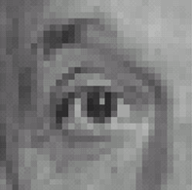
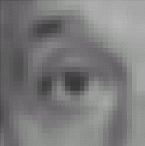
Linear filters: examples
1
1
1
=
1
1
1
1
1
1
Original
Blur (with a mean filter)
Source: D. Lowe

Slide 14
Practice with linear filters
0
0
0
?
0
1
0
0
0
0
Original
Source: D. Lowe

Slide 15
Practice with linear filters
0
0
0
0
1
0
0
0
0
Original
Filtered
(no change)
Source: D. Lowe

Slide 16
Practice with linear filters
0
0
0
?
0
0
1
0
0
0
Original
Source: D. Lowe

Slide 17
Practice with linear filters
0
0
0
0
0
1
Convolutional Filter Weights
0
0
0
0
0
0
Original
0
0
1
Shifted right
By 1 pixel
0
0
0
Sliding Mask (Correlation) Weights
Source: D. Lowe

Slide 18
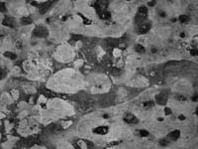
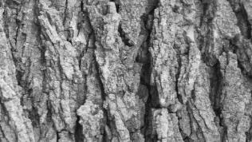
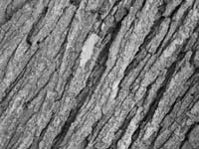
Can you match the texture to the response?
Filters
A
B
1
2
C
3
Mean abs responses
Notes:
1-B
2-C
3-A

Slide 19
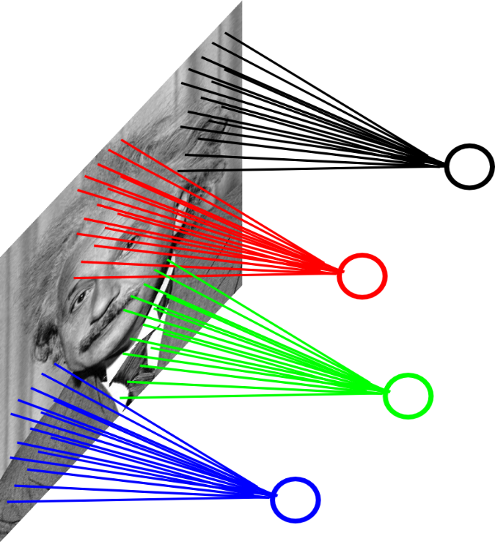
Locally Connected Layers
Example: 200x200 image
40K hidden units
Filter size: 10x10 → 4M parameters
Note: This parameterization is good when
input image is registered (e.g., face recognition).
Ranzato

Slide 20
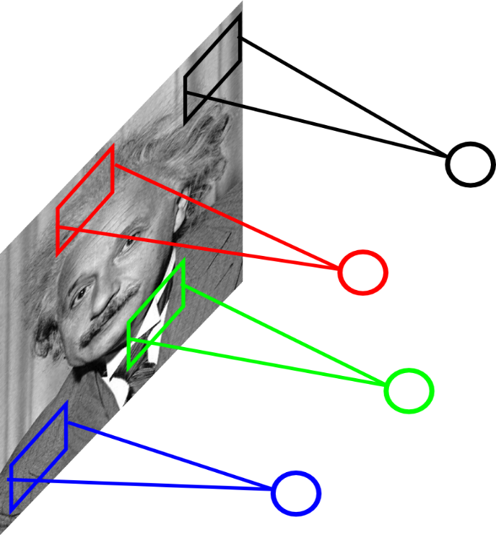
Locally Connected Layers
STATIONARITY? Statistics is similar at
different locations
Example: 200x200 image
40K hidden units
Filter size: 10x10 → 4M parameters
Ranzato

Slide 21
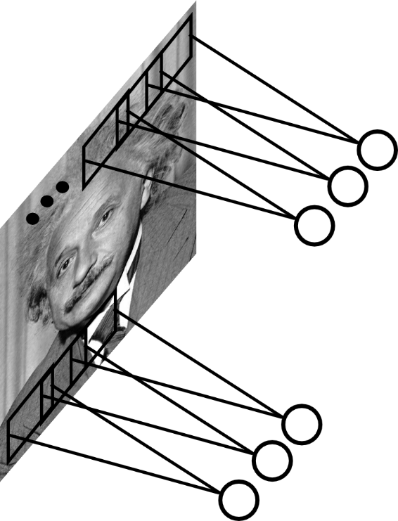
Convolutional Layer
Share the same parameters across different
locations (assuming input is stationary):
Convolutions with learned kernels
Ranzato

Slide 22
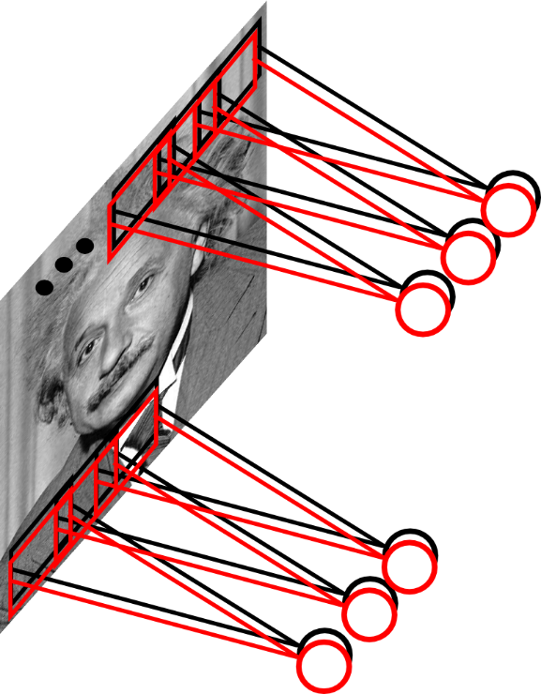
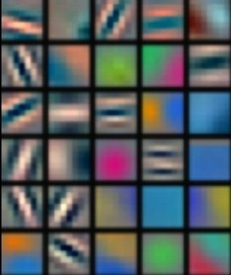
Convolutional Layer
Learn multiple filters.
E.g.: 200x200 image
100 Filters
Filter size: 10x10
10K parameters
Ranzato

Slide 23
Convolution Layer
32x32x3 image
32
height
32
width
3
Depth (color)

Slide 24
Convolution Layer
32x32x3 image
5x5x3 filter
32
Convolve the filter with the image
i.e. “slide over the image spatially, computing dot products”
32
3

Slide 25
Convolution Layer
Filters always extend to the full depth of the input volume
32x32x3 image
5x5x3 filter
32
Convolve the filter with the image
i.e. “slide over the image spatially, computing dot products”
32
3

Slide 26
Convolution Layer
32x32x3 image
5x5x3 filter
32
1 number:
the result of taking a dot product between the filter and a small 5x5x3 chunk of the image
(i.e. 5*5*3 = 75-dimensional dot product + bias)
32
3

Slide 27
Convolution Layer
activation map
32x32x3 image
5x5x3 filter
32
28
convolve (slide) over all spatial locations
32
28
3
1

Slide 28
consider a second, green filter
Convolution Layer
32x32x3 image
5x5x3 filter
activation maps
32
28
convolve (slide) over all spatial locations
32
28
3
1

Slide 29
For example, if we had 6 5x5 filters, we’ll get 6 separate activation maps:
activation maps
32
28
Convolution Layer
32
28
3
6
We stack these up to get a “new image” of size 28x28x6!

Slide 30
“Tensors” again
Because there are multiple channels in each data block, convolutional filters are normally specified by 4D arrays. Common dimensions are:
$$C_{out}×C_{in}×F_{H}×F_{W}$$
$C_{out}$ = number of output channels $C_{in}$ = number of input channels $F_{H}$ = filter height $F_{W}$ = filter width

Slide 31
Preview: ConvNet is a sequence of Convolution Layers, interspersed with non-linear activation functions
32
28
CONV,
ReLU
e.g. 6 5x5x3 filters
32
28
3
6

Slide 32
Preview: ConvNet is a sequence of Convolution Layers, interspersed with non-linear activation functions
32
28
24
….
CONV,
ReLU
e.g. 6 5x5x3 filters
CONV,
ReLU
e.g. 10 5x5x6 filters
CONV,
ReLU
32
28
24
3
6
10

Slide 33
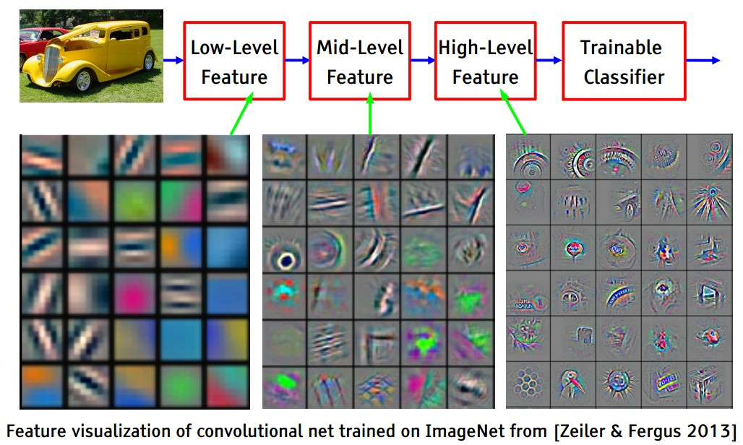
Recall

Slide 34
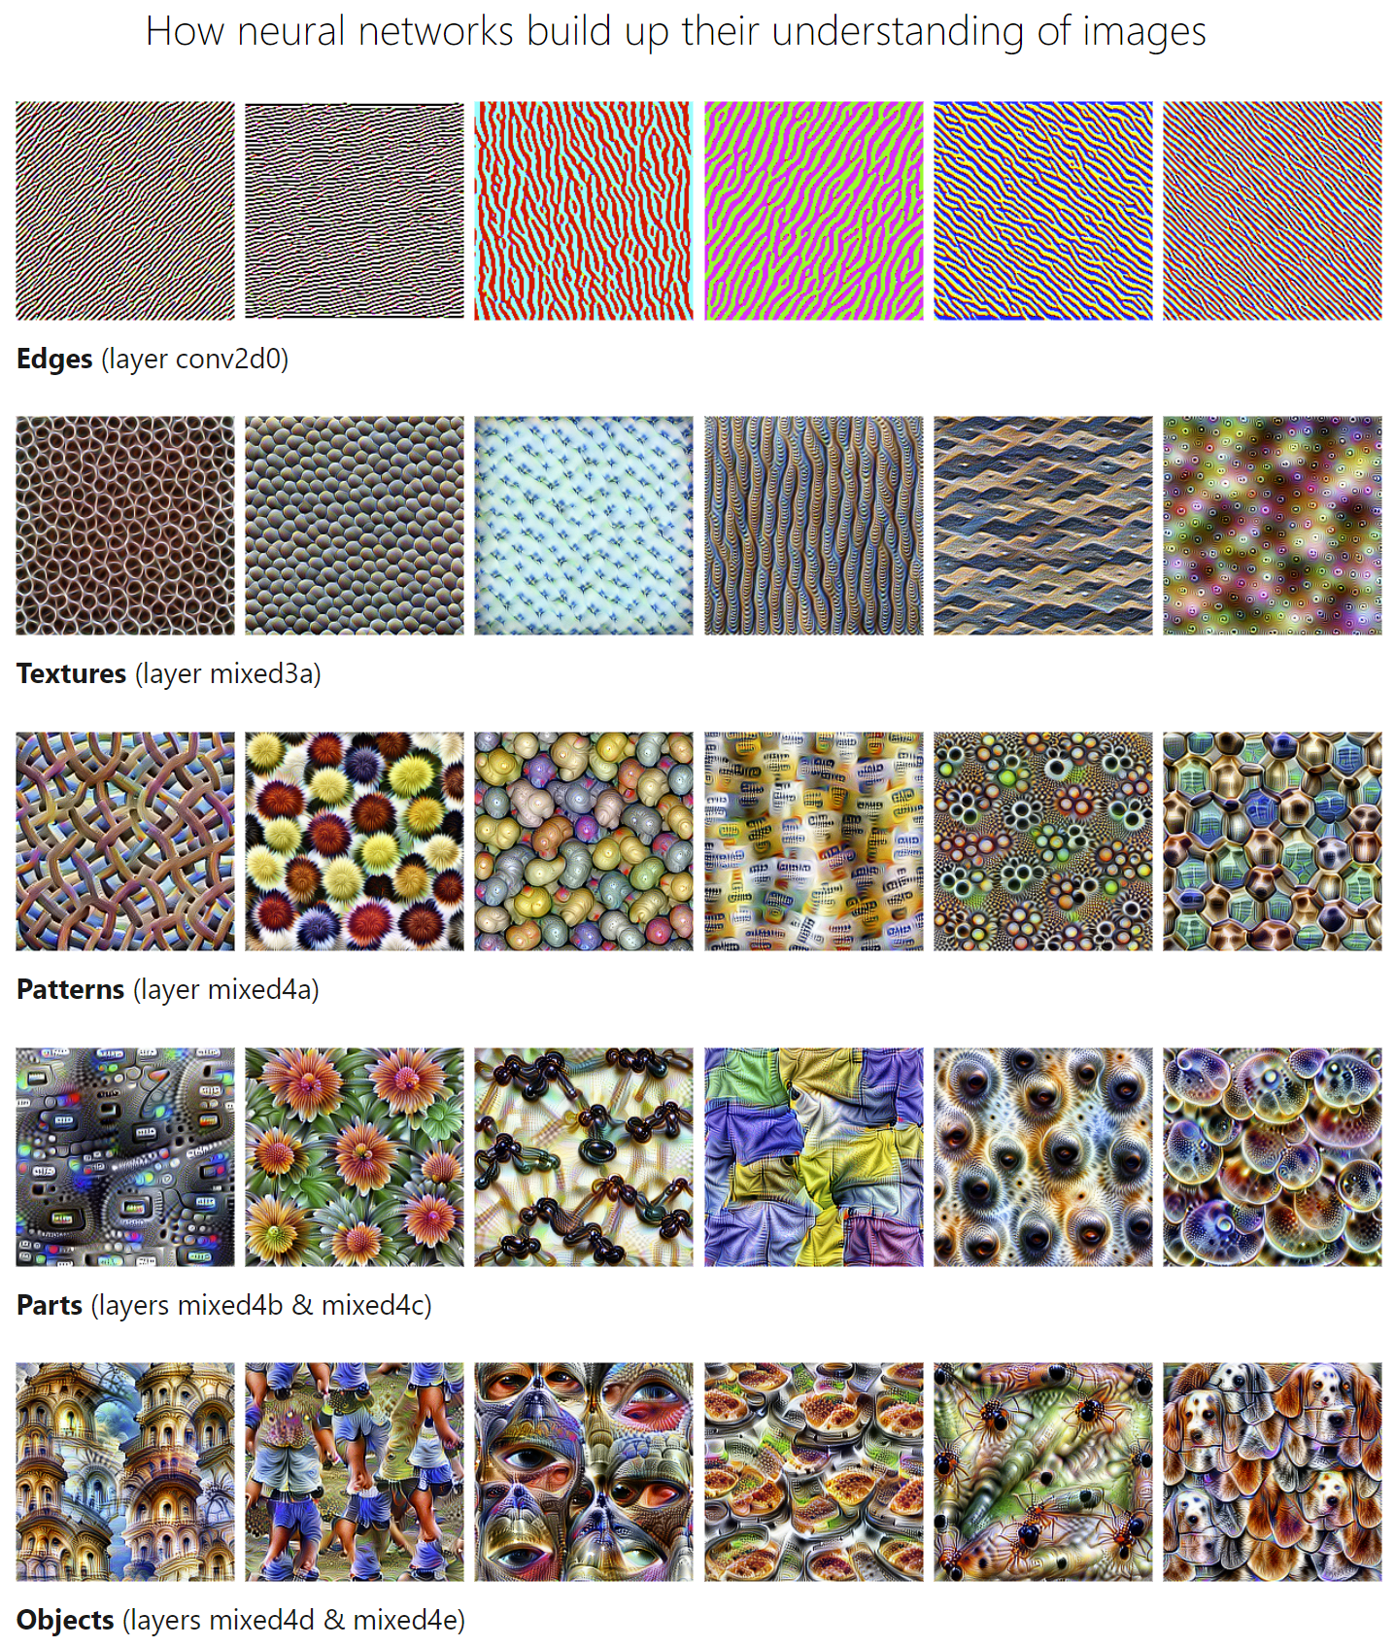
Visualizing the features
https://distill.pub/2017/feature-visualization/

Slide 35
“Tensors” (not really)
Deep networks are often applied to structured data like images or time series or texts.
Activations are also grouped into minibatches of some dimension N.
Its useful to organize layer activations and model weights to represent this structure. They are therefore most naturally represented as multi-dimensional arrays (incorrectly called “tensors”).
e.g. the activations in layers of most 2D image processing networks have dimensions:
N x C x H x W or N x H x W x C
N = minibatch dimension C = number of channels or filters H = image height W = image width

Slide 36
“Tensors” (not really)
Alexnet (simplified): The 3D blocks show activations with C, H, W dimensions. N, the minibatch dimension, is not shown.
H
W
C

Slide 37
Convnets Summary
Convolution layers represent local, shift-invariant operations on data blocks.
Layer activations commonly organized into 4D blocks, NCHW or NHWC.
Convolutional filters are also usually 4D arrays, e.g. $C_{out}C_{in}F_{H}F_{W}$
Convnets typically follow conv layers with ReLU non-linearities.
Spatial resolution decreases through the network, while number of channels increases.
Pooling layers or strided convolutions reduce the spatial resolution in steps.
Typical applications in image classification use additional fully connected layers and a final softmax for classification.

